Slide 1
Transparency, Technology and You
Chris DiBona
Open Source and Public Sector Programs, Google.
cdibona@google.com

Slide 2

First off, Thanks
For DARPA
For The Internet
For Releasing Information
Without these things, Google wouldn’t exist or be as useful.
(why is the logo so jaggie?)
Notes:
The Government does a pretty good job of this, mostly.

Slide 3
High Res Logo, Please
Q: How do I obtain a high resolution version of the DARPA logo?
A: At this time DARPA is not able to approve use of the DARPA logo. We are in the process of developing a formal trademark licensing program, and have had to put a moratorium on logo use until we have the program in place. Within the next six to 12 months, we hope to have details available.
(undated, source: http://www.darpa.mil/faq.html)

Slide 4
But What about 17 USC 105?
Subject matter of copyright: United States Government works: Copyright protection under this title is not available for any work of the United States Government, but the United States Government is not precluded from receiving and holding copyrights transferred to it by assignment, bequest, or otherwise.
  Trademarks are not mentioned…..so that covers the logo?

Slide 5
My Point
Transparency is up to you.
Plug openness into your app from day one
Keep your idealism intact.
Notes:
For now and future admisitrations.

Slide 6
Google and Openness
We build on top of open source software
  Plus our unique development on top of that.
  Plus other sources of data and imagery.
We crawl pages open to all (most of the time)
That are hosted on the open internet
Which is based on open source software
Implementing open standards
Then release as much back as we can
We let you leave and take your data with you.

Slide 7
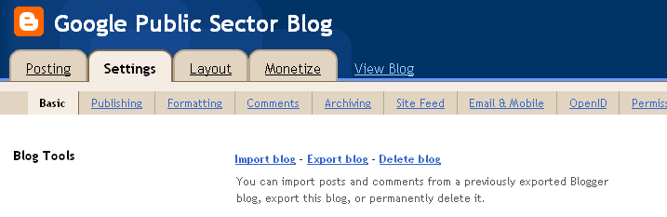
Export, Import and Delete: Gmail
Contacts, Filters, Mail, and more.
Also: Support standard open access methods
  IMAP
  POP3
See also, Blogger:

Slide 8


Government Example: USPTO
Anyone can search
No registration is needed
Easy to use and powerful interface.
Data dumps are readily available, if a bit costly. Example: ~8k/decade of patent docs, a bit more for recent timely applications.
Notes:
Darpa TM Filed in January 6, 2006
1990s 1.4m patents
(And I did, for Darpa..)
vint cerf will be talking about platforms.

Slide 9
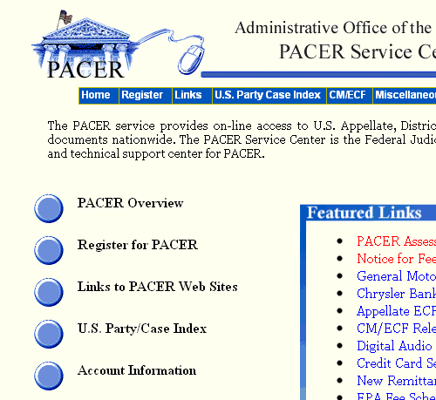
Anti-Example: PACER
8 ¢/page
Requires CC info
Difficult to search
Difficult to register
PDF
No free results
42x USPTO Fees
Notes:
If uspto followed that model, they’d charge 28x as much. (Assuming 3 pages per patents)

Slide 10
So Remember….
It is up to all of you
For now
For the next decade+
And thanks again for the Internet.
Chris DiBona
cdibona@google.com
http://dibona.com
http://twitter.com/cdibona
http://code.google.com/opensource
Notes:
Do it for now, but do it for the USA for later.

